Slide 1





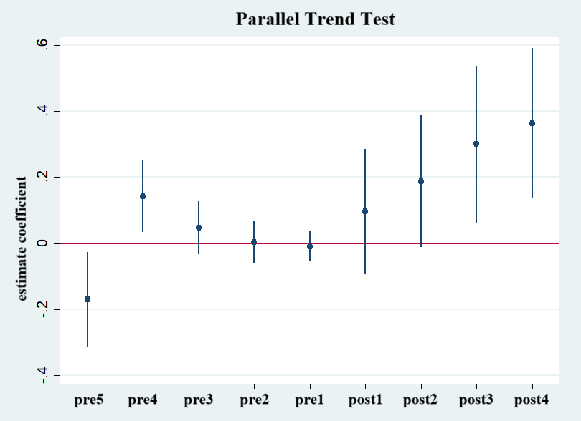






Assessing the Impact of Subsidized Housing Policy on Urban Housing Affordability
An Empirical PSM-DOD Analysis of Large and Medium-sized Cities in China
Ding Zhiyin
(Department of Urban Planning and Design, The University of Hong Kong)
1. Introduction
Urbanization & Housing Crisis
China’s urbanization rate grew from 17.9% in 1978 to 66.2% in 2023. Sustained housing price growth brings affordability pressure to new residents and young groups.
Policy Intervention (14th Five-Year Plan)
China launched subsidized rental housing policies in 2021. The country plans to build 8.7 million subsidized housing units and it aims to ease housing market pressure and supports disadvantaged groups.
4. Methodology
1. Introduction
PXi=PrDi=1|Xi=expα+βXi1+expα+βXi｛｝｛｝
the parallel trend hypothesis holds, and the policy effect gradually releases and strengthens over time, which also proves the authenticity and robustness of the PSM DID estimation results.
  Urbanization & Housing Crisis
China’s urbanization rate grew from 17.9% in 1978 to 66.2% in 2023. Sustained housing price growth brings affordability pressure to new residents and young groups.
ln_ipr | Coef.
pre5 | 0.1425451
pre4 | 0.0471316
pre3 | 0.003391
pre2 | -0.0100032
post1 | 0.0970171
post2 | 0.1876454
post3 | 0.2996051
post4 | 0.3634114
  Policy Intervention (14th Five-Year Plan)
China launched subsidized rental housing policies in 2021. The country plans to build 8.7 million subsidized housing units and it aims to ease housing market pressure and supports disadvantaged groups.
Propensity score matching
DID Regression
Fig 1. Quantitative analysis flow chart
2.Research Aims & Question
Tab 1. Variable list
Fig 2. Parallel trend test
Category | Variable
City information | province, city name, city code, year
Urban development | share of tertiary industry, urbanization rate, public revenue, public expenditure
Population | average income, resident population, population density, average consume, average GDP
Real estate | average residential housing price, residential housing sale area, residential housing sale volume
This study aims to evaluate policy impacts on housing affordability among different cities.
6. Research Conclusions
1.To what extent does the policy improve housing affordability?
1
The subsidised housing pilot policy significantly improves housing affordability.
2. What are the lagged and long-term dynamics of the policy?
2
The policy effects have a clear time lag and long-term cumulative characteristics.
3. How does the impact vary by city characteristics?
Data sources:
China Urban Statistical Yearbook, Anjuke Housing Trading Platform, etc.
3
Urban heterogeneity has a significant impact on housing affordability.
3. Research Design
5. Quantitative analysis results
1. Introduction
Urbanization & Housing Crisis
China’s urbanization rate grew from 17.9% in 1978 to 66.2% in 2023. Sustained housing price growth brings affordability pressure to new residents and young groups.
Policy Intervention (14th Five-Year Plan)
China launched subsidized rental housing policies in 2021. The country plans to build 8.7 million subsidized housing units and it aims to ease housing market pressure and supports disadvantaged groups.
PXi=PrDi=1|Xi=expα+βXi1+expα+βXi｛｝｛｝
Theoretical Framework
Research Design
Tab 2. PSM balance test
7. Policy Implications
Theoretical basis
Policy identification & panel data construction
40 pilot cities · City-level panel data 2016–2024 · Treatment group defined
Sample | Ps | R2 | LR | chi2 | p>chi2 | MeanBias | MedBias | B | R | %Var
Unmatched | 0.892 |  | 208.25 |  | 0 | 197.6 | 175.3 | 203.5 | 345.5* | 33
Matched | 0.431 |  | 4.77 |  | 0.573 | 27.5 | 19.9 | 11.6 | 87.6* | 0
* if B>25%, R outside [0.5; 2]
Dynamic Monitoring & Long-Term Planning
Local governments should build a database to track everything from planning to resident satisfaction, review the results yearly, and adjust where needed.
Filtering theory
Housing succession fails under sustained price inflation
Government intervention theory
Supply-side correction for housing market failure
Policy context
Data processing & indicator measurement
Clean & standardise variables · Compute IPR · Log-transform all except tertiary share & urbanisation rate
Expand Policy Coverage
During the 15th Five-Year Plan period, pilot scope should expand, especially to second- and third-tier cities with large net population inflows.
14th Five-Year Plan subsidised rental housing policy (2021)
After the matching, the covariate bias between the experimental group and the control group was controlled within 30%.
Empirical design
Propensity score matching (PSM)
Mean dependent var | 1.629 | SD dependent var | 0.318
R-squared | 0.818 | Number of obs | 89
F-test | . | Prob > F | .
Akaike crit. (AIC) | -254.751 | Bayesian crit. (BIC) | -229.865
*** p<.01, ** p<.05, * p<.1
Research Question
Difference-in-differences regression (DID)
Tab 4. DID regression result
Cross-Regional Coordination
Eastern cities already have good experience in building standards, operation models, and funding. National authorities should regularly organise policy exchanges and share successful cases.
ln_ipr | Coef. | St.Err. | t-value | p-value | 95% Conf | Interval | Sig
treat#1 : base 0 | 0.247 | 0.027 | 9.13 | 0 | 0.186 | 0.308 | ***
Adapt to Local Conditions
Different cities vary greatly in population density, stage of urbanisation and industrial structure, so policy design should be precise.
PSM-DID empirical analysis
Dynamic effect analysis & robustness checks
Parallel trends assumption test · Event-study approach
DID regression results showed a significant positive impact of the pilot policy on housing affordability.

